Slide 1
MODULE CODE: AP80167
MODULE TITLE: PHYSICS FOR IT
BY
Dr Jean de Dieu Niyonzima
Tel: 0787413244
University of Rwanda, CST, LEVEL 1

Slide 2
Assessment Pattern
Component | Weighting(%)
Assignments and Lab repots | 10
Quizzes | 10
One Continuous Assessment Test(CAT) in the middle of the module | 30
Final written Exam | 50

Slide 3
Indicative Content
Part 1: Electricity
Part 2: Magnetism

Slide 4
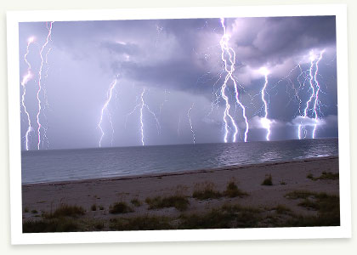
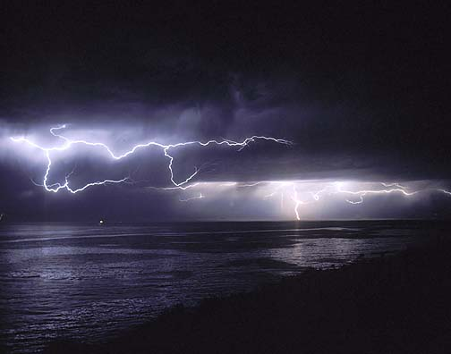
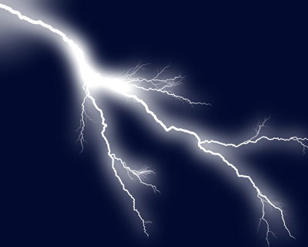
ELECTRICITY

Slide 5
0. Course outline
Electric forces and electric fields: Properties of electric charges, Insulation and conductors, electrification; Coulomb’s law, the electric field, Electric field lines, Electric flux.
Electric energy and capacitance: Electric potential, Potential energy due to point charges, equipotential surfaces, Capacitance, Combination of capacitors, Energy stored in a charged capacitor, dielectrics.
Current and resistance: Electric current, Ohm’s law, Resistivity and resistance, Electromotive force, Generators, Electric circuit, Resistors in series, Resistors in parallel, Kirchhoff’s laws, Electrical energy and power, Electrical safety

Slide 6
1. Introduction
Electricity is a general term encompassing a variety of phenomena resulting from the presence and flow of electric charges.
These include many easily recognizable phenomena, such as lightning, static electricity, and the flow of electrical current in electrical wires.
In addition, electricity encompasses (includes) less familiar concepts such as the electromagnetic field and electromagnetic induction.

Slide 7
2. Electric charge
Charge originates in the atom, in which its most familiar carriers are the electron and proton.

Slide 8
2. Electric charge
Atom Parts:
  Electrons: Negative part of an atom.
  Protons: Positive part of an atom.
  Neutrons: No charged part of an atom.
E
E
E
E
E
P
N
N
P
E
E
E
E
E

Slide 9
2. Electric charge
There are two types of observed electric charge: positive and negative.
The convention was derived from Benjamin Franklin’s experiments.
Charge with opposite electrical sign (i.e. a positive charge and a negative charge) attract each other and charge with the same electrical sign (i.e. two positive charges or two negative charges)repel each other.

Slide 10
2. Electric charge
The smallest unit of “free” charge known in nature is the charge of an electron or proton, which has a magnitude of
Charge comes in multiples of an indivisible unit of charge, represented by the letter e.
These things have the same size charge, but the sign is different.
A proton has a charge of +e, while an electron has a charge of –e.

Slide 11
2. Electric charge
Putting "charge is quantified" in terms of an equation, we say:
q = n e
where q is the symbol used to represent charge, while n is a positive or negative integer, and e is the electronic charge, 1.60 x 10⁻¹⁹ C.

Slide 12
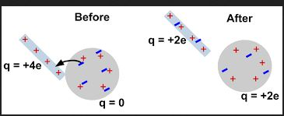
2.1. Conservation of Charge
The Law of conservation of charge states that “The net charge of an isolated system remains constant.”
If a system starts out with an equal number of positive and negative charges, there is nothing we can do to create an excess of one kind of charge in that system unless we bring in charge from outside the system (or remove some charge from the system).
Likewise, if something starts out with a certain net charge, say +100e, it will always have +100e unless it is allowed to interact with something external to it.

Slide 13
2.1. Conservation of Charge
Charge can be created and destroyed, but only in positive-negative pairs.
Within the system, charge may be transferred between bodies, either by direct contact, or by passing along a conducting material, such as a wire.
The informal term static electricity refers to the net presence (or 'imbalance') of charge on a body, usually caused when dissimilar materials are rubbed together, transferring charge from one to the other.

Slide 14
2.2. Electrostatic charging
Forces between two electrically-charged objects can be extremely large.
Most things are electrically neutral; they have equal amounts of positive and negative charge. If this wasn’t the case, the world we live in would be a much stranger place.
We also have a lot of control over how things get charged. This is because we can choose the appropriate material to use in a given situation.

Slide 15
2.2. Electrostatic charging
Metals are good conductors of electric charge, while plastics, wood, and rubber are not. They are called insulators.
Charge does not flow easily through insulators as it does through conductors, which is why wires you plug into a wall socket are covered with a protective rubber coating. Charge flows along the wire, but not through the coating to you.

Slide 16
2.2. Electrostatic charging
Materials are divided into three categories, depending on how easily they will allow charge (i.e., electrons) to flow along them. These are:
conductors - metals, for example
semi-conductors - silicon is a good example
insulators - rubber, wood, plastic for example

Slide 17
Most materials are either conductors or insulators.
The difference between them is that in conductors, the outermost electrons in the atoms are so loosely bound to their atoms that they are free to travel around.
In insulators, on the other hand, the electrons are much more tightly bound to the atoms, and are not free to flow. Semi-conductors are a very useful intermediate class, not as conductive as metals but considerably more conductive than insulators.
By adding certain impurities to semi-conductors in the appropriate concentrations the conductivity can be well-controlled.

Slide 18
Energy Band Diagrams
  Valence Electrons are those electrons which are located in the outermost or “Valence” shell of an atom.
  The number of valence electrons an atom has determines the electrical properties of that atom.
  < 4 electrons => Conductor
  > 4 electrons => Insulator
  4 electrons => Semiconductor

Slide 19
2.2. Electrostatic charging
There are three ways that objects can be given a net charge. These are:
Charging by friction - this is useful for charging insulators.
If you rub one material with another (say, a plastic ruler with a piece of paper towel), electrons have a tendency to be transferred from one material to the other.

Slide 20
2.2. Electrostatic charging
b) Charging by contact - useful for charging metals and other conductors.
If a charged object touches a conductor, some charge will be transferred between the object and the conductor, charging the conductor with the same sign as the charge on the object.

Slide 21
2.2. Electrostatic charging
c) Charging by induction - also useful for charging metals and other conductors.
Again, a charged object is used, but this time it is only brought close to the conductor, and does not touch it.

Slide 22
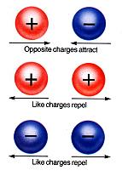
3. Coulomb’s law (inter-action between charges)
Two electric charges of the same sign repel and two electric charges of opposite sign attract each other with a force that is proportional to the product of their charges and inversely proportional to the square of the distance between them.

Slide 23

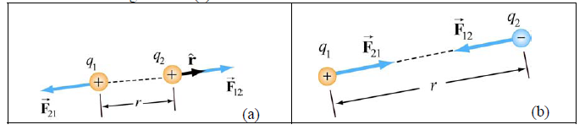

3. Coulomb’s law
If we consider a system of two charges separated by a distance r, the force between those two charges is given by

Slide 24


3. Coulomb’s law
Note that electric force is a vector which has both magnitude and direction.
In SI units, the Coulomb’s constant k is given by
where ε₀ is permittivity of free space

Slide 25
3.1. Principle of superposition
Coulomb’s law applies to any pair of point charges.
When more than two charges are present, the net force on any one charge is simply the vector sum of the forces exerted on it by the other charges.
For example, if three charges q₁, q₂ and q₃ are present, the resultant force experienced by q₃ due to q₁ and q₂ will be

Slide 26
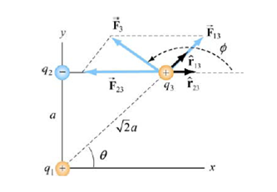
3.1. Principle of superposition

Slide 27

3.1. Principle of superposition
For a system of N charges, the net force experienced by the j^{th} particle would be
Where denotes the force between particles i and j.
The superposition principle implies that the net force between any two charges is independent of the presence of other charges, This is true if the charges are in fixed positions.

Slide 28
4. Electric Field
The region around a charged body within which it can exert its electrostatic influence may be called an electric field.
In principle, it extends to infinity, but in practice it falls off more or less rapidly with distance.
We can define the intensity or strength E of an electric field as follows: Suppose that we place a small test charge +q in an electric field. This charge will then experience a force.

Slide 29
The ratio of the force to the charge is called the intensity of the electric field, or, more usually, simply the electric field.
Thus we have used the words “electric field” to mean either the region of space around a charged body, or, quantitatively, to mean its intensity.
Usually it is clear from the context which is meant, but, if you wish, you may elect to use the longer phrase “intensity of the electric field” if you want to remove all doubt.

Slide 30

The field and the force are in the same direction, and the electric field is a vector quantity, so the definition of the electric field can be written as
We take q₀ to be infinitesimally small so that the field generates does not disturb the “source charges.”

Slide 31


Using the definition of electric field and the Coulomb’s law, the electric field at a distance r from a point charge q is given by
Using the superposition principle, the total electric field due to a group of charges is equal to the vector sum of the electric fields of individual charges:

Slide 32
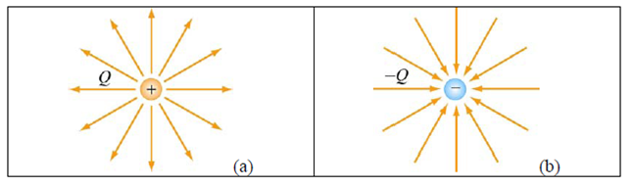
4.1. Electric Field Lines
Electric field lines provide a convenient graphical representation of the electric field in space.
The field lines for a positive and a negative charges are shown in figure below

Slide 33
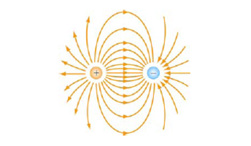
4.1. Electric Field Lines
Notice that the direction of field lines is radially outward for a positive charge and radially inward for a negative charge.
For a pair of charges of equal magnitude but opposite sign (an electric dipole), the field lines are shown in figure below:

Slide 34
4.1. Electric Field Lines
The pattern of electric field lines can be obtained by considering the following:
a) Symmetry: For every point above the line joining the two charges there is an equivalent point below it. Therefore, the pattern must be symmetrical about the line joining the two charges;
b) Near field: Very close to a charge, the field due to that charge predominates. Therefore, the lines are radial and spherically symmetric;

Slide 35

4.1. Electric Field Lines
c) Far field: Far from the system of charges, the pattern should look like that of a single point charge of value . Thus, the lines should be radially outward, unless Q=0;
d) Null point: This is a point at which , and no field lines should pass through it.

Slide 36
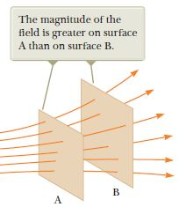
4.1. Electric Field Lines
The properties of electric field lines may be summarized as follows:
The direction of the electric field vector at a point is tangent to the field lines;
The number of lines per unit area through a surface perpendicular to the line is devised to be proportional to the magnitude of the electric field in a given region;
The field lines must begin on positive charges (or at infinity) and then terminate on negative charges (or at infinity);

Slide 37
4.1. Electric Field Lines
The number of lines that originate from a positive charge or terminating on a negative charge must be proportional to the magnitude of the charge;
No two field lines can cross each other; otherwise the field would be pointing in two different directions at the same point pass through it.

Slide 38
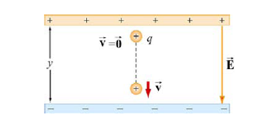
4.1. Force on a Charged Particle in an Electric Field
Consider a charge +q moving between two parallel plates of opposite charges, as shown in Figure below:

Slide 39

4.1. Force on a Charged Particle in an Electric Field
Let the electric field between the plates be
  The charge will experience a downward Coulomb force
  According to Newton’s second law, a net force will cause the charge to accelerate with an acceleration,
Notes:
Ey must be greater than zero

Slide 40


4.1. Force on a Charged Particle in an Electric Field
Suppose the particle is at rest (v=0) when it is first released from the positive plate. The final speed v of the particle as it strikes the negative plate is given by
where y is the distance between the two plates. The kinetic energy of the particle when it strikes the plate is given by
Notes:
Ey must be greater than zero

Slide 41
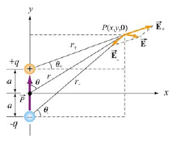
4.3. Electric Dipole
An electric dipole consists of two equal but opposite charges, +q and −q, separated by a distance 2a, as shown in the figure below:

Slide 42
4.3. Electric Dipole
The dipole moment vector which points from -q to +q (in the y-direction) is given by

Slide 43

4.3. Electric Dipole
The magnitude of the electric dipole is
with
For an overall charge-neutral system having N charges, the electric dipole vector is defined as
Where is the position vector of the charge

Slide 44
4.3. Electric Dipole
An electric dipole is a separation of positive and negative charges. The simplest example of this is a pair of electric charges of equal magnitude but opposite sign, separated by some (usually small) distance. A permanent electric dipole is called an electret.
Examples of dipoles include HCl, CO, H₂O and other polar molecules. In principle, any molecule in which the centers of the positive and negative charges do not coincide may be approximated as a dipole.

Slide 45
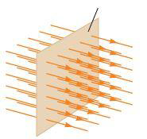


Field lines representing a uniform electric field penetrating a plane of area perpendicular to the field
Consider an electric field that is uniform in both magnitude and direction as shown in Figure at left side. The field lines penetrate a rectangular surface of area whose plane is oriented perpendicular to the field. The number of lines per unit area (in other words, the line density) is always proportional to the magnitude of the electric field. Therefore, the total number of lines penetrating the surface is proportional to the product EA. This product of the magnitude of the electric field and surface area perpendicular to the field is called the electric flux. From the SI units of E and A, we see that has units of Newton meters squared per coulomb
.

Slide 46


4.5. Electric flux
If the surface under consideration is not perpendicular to the field, the flux through it must be less than that given by the equation above.
To calculate the flux through a particular surface, multiply the surface area by the component of the electric field perpendicular to the surface.
From this result, we see that the flux through a surface of fixed area A has a maximum value EA when the surface is perpendicular to the field (when the normal to the surface is parallel to the field, that is, when
); the flux is zero when the surface is parallel to the field
(when the normal to the surface is perpendicular to the field, that is, when
Where is the angle between the electric field and the normal to the surface

Slide 47


4.6. Gauss’s law
Gauss’s law states that “the flux of the electric field over the Gaussian surface equals to the net charge enclosed by that surface.”
The integral form of Gauss’s law:

Slide 48
Exercise 1
The electron and proton of a hydrogen atom are separated (on the average) by a distance of approximately
Find the magnitudes of the electric force and the gravitational force between the two particles.

Slide 49
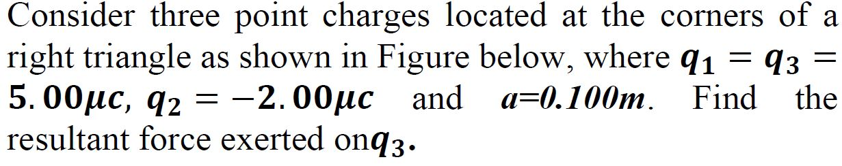
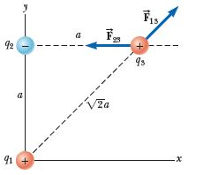
Exercise 2

Slide 50
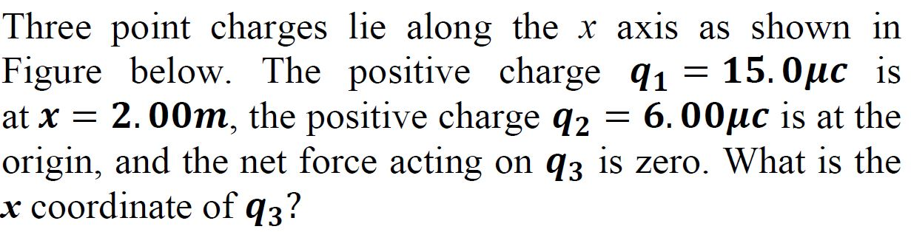
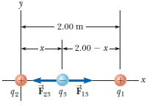
Exercise 3

Slide 51
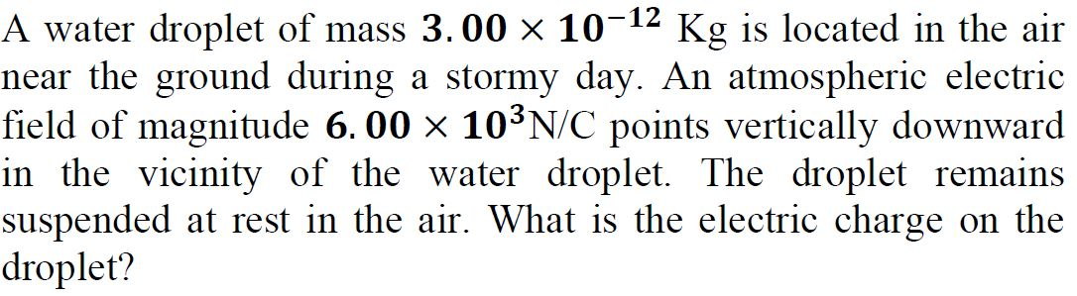
Exercise 4

Slide 52
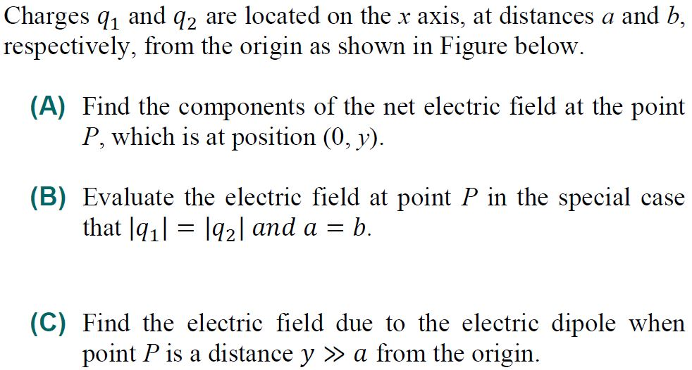
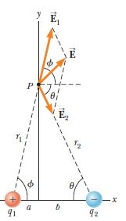
Exercise 5

Slide 53
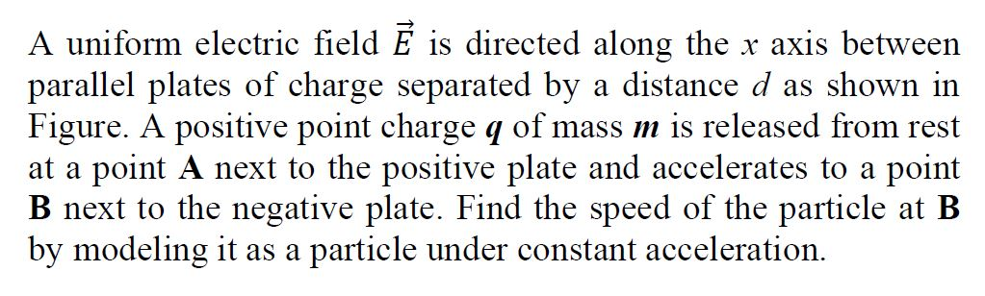
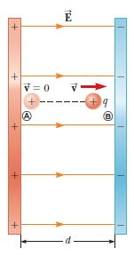
Exercise 6

Slide 54
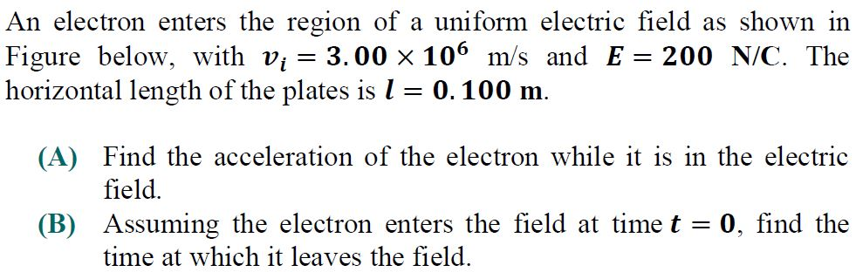
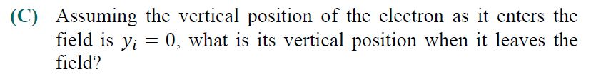
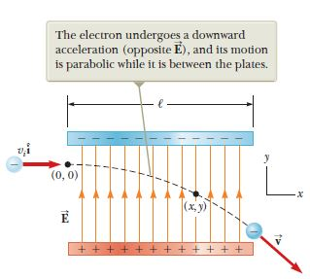
Exercise 7

Slide 55
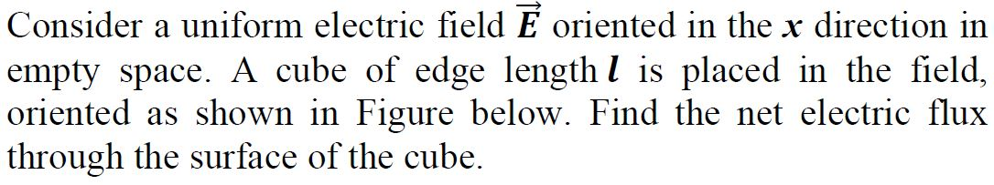
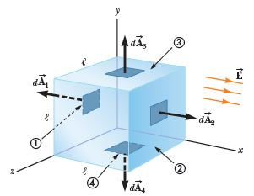
Exercise 8

Slide 56
QUIZ 1

Slide 57
5. Electric Potential or Voltage
The best way to think about the meaning of electric potential, or voltage, is to make an analogy with gravity.
When a mass is high above the ground we say that it has a lot of potential energy because if we drop it, it strikes the ground hard.
We say that the potential energy due to height has been converted into kinetic energy. We can say the same things about electricity.

Slide 58
5. Electric Potential or Voltage
If two positive charges are close together and we release them, they will repel each other and pick up speed, their electric potential energy having been converted into kinetic energy.
In this analogy, the electrical quantity which corresponds to height is voltage.

Slide 59

5. Electric Potential or Voltage
The definition of the potential difference between two points, a and b, in space is
Where this integral is a path integral, or line integral.
For electric fields made by electric charges, the answer for the voltage difference is the same no matter what path is chosen.

Slide 60

5. Electric Potential or Voltage
Applying the previous definition to the field of a point charge, q, and choosing the convention that the voltage is zero at infinity, we obtain the formula for the voltage produced at any point in space by a point charge:
Where r is the distance from the point charge to the point at which it is desired to know V.

Slide 61
5. Electric Potential or Voltage
This formula says that the voltage is large and positive near positive charges and large and negative near negative charges.

Slide 62
5.1. Equipotential Surfaces
An equipotential surface is a surface on which the potential, or voltage, is constant.
Electric field lines are always perpendicular to these surfaces, and the electric field points from surfaces of high potential to surfaces of low potential.
Note that this means that the electric field is strong where the equipotential surfaces are close together and, weak where they are far apart.

Slide 63

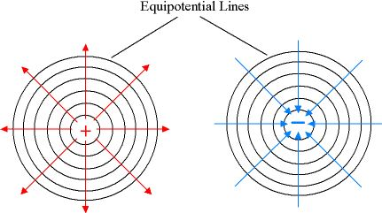
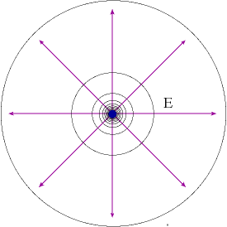
5.1. Equipotential Surfaces

Slide 64
5.2. Potential Energy
The potential energy of a charge, q, at a point in space where the voltage due to all charges is V, is given by the formula

Slide 65

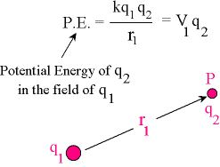
5.2. Potential Energy
for the potential energy of two point charges, q₁ and q₂ , separated by a distance r₁₂ is equal to:

Slide 66
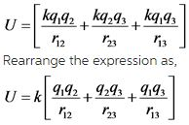
5.2. Potential Energy
The potential energy of the group is simply the sum of the potential energies for all the pairs of charges in the group.
For instance, for a group of four charges the total potential energy would be
An example of a group of three charges

Slide 67
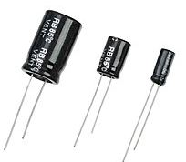

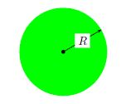
6. Capacitors
A capacitor is an arrangement of conductors that is used to store electric charge.
A very simple capacitor is an isolated metallic sphere.
The potential of a sphere with radius R and charge Q is equal to

Slide 68
6. Capacitors
The previous equation shows that the potential of the sphere is proportional to the charge Q on the conductor.
This is true in general for any configuration of conductors.
This relationship can be written as
where C is called the capacitance of the system of conductors.
The unit of capacitance is the farad (F).

Slide 69

6. Capacitors
The capacitance of the metallic sphere is equal to
This formula shows that the capacitance of a metallic sphere depends only on the geometry of the sphere not on the electric charges that it carries.
This is true in general for any configuration of conductors.

Slide 70
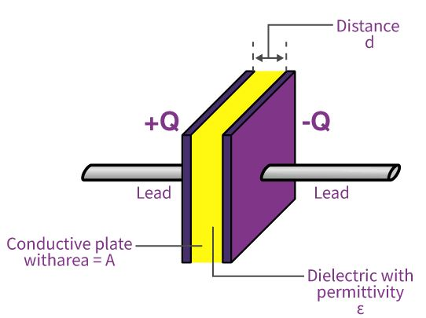

6.1. The parallel-plate capacitor
Another example of a capacitor is a system consisting of two parallel metallic plates.
The potential difference between two plates of area A, separated by a distance d, and with charges +Q and -Q, is given by:

Slide 71

6.1. The parallel-plate capacitor
Using the definition of the capacitance, the capacitance of this system can be calculated:

Slide 72
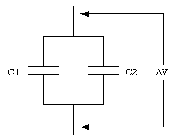
6.2. Capacitors in Combination
Capacitors can be connected together; they can be connected in series or in parallel.
The figure below shows two capacitors, with capacitance C₁ and C₂, connected in parallel.

Slide 73

6.2. Capacitors in Combination
The potential difference across both capacitors must be equal and therefore

Slide 74
6.2. Capacitors in Combination
Using equation , the total charge on both capacitors can be calculated
These two capacitors can be treated as one capacitor with a capacitance C; where C is related to C₁ and C₂ in the following manner

Slide 75
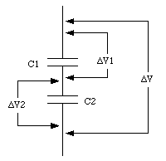
6.2. Capacitors in Combination
Figure below shows two capacitors, with capacitance C₁ and C₂, connected in series.

Slide 76

6.2. Capacitors in Combination
The total voltage difference across the two capacitors is given by

Slide 77

6.2. Capacitors in Combination
The system acts like a single capacitor C whose capacitance can be obtained from the following formula

Slide 78

6.4. Energy in Capacitors
The electric potential energy of a capacitor containing no dielectric and with charge +/-Q on its plates is given by
Where V₁ and V₂ are the potentials of the two plates.

Slide 79

6.4. Energy in Capacitors
The electric potential energy can also be expressed in terms of the capacitance C of the capacitor
This formula is also correct for a capacitor with a dielectric; the properties of the dielectric enter into this formula via the capacitance C.

Slide 80
Exercise 9
Find the equivalent capacitance between a and b for the combination of capacitors shown in Figure below. All capacitances are in microfarads.

Slide 81
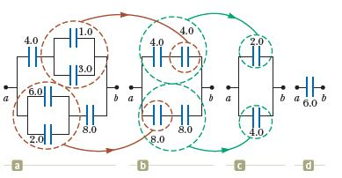
Solution

Slide 82
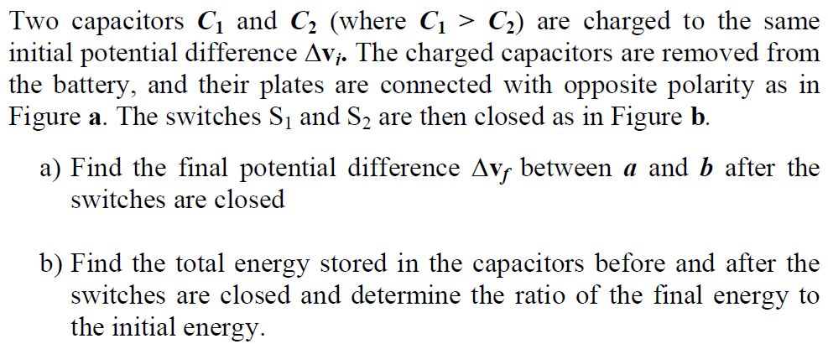
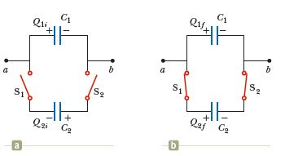
Exercise 10

Slide 83
7. Electric current
The movement of electric charges is known as an electric current, the intensity of which is usually measured in amperes (A).
Electric current can consist of any moving charged particles; most commonly these are electrons, but any charge in motion constitutes an electric current.

Slide 84
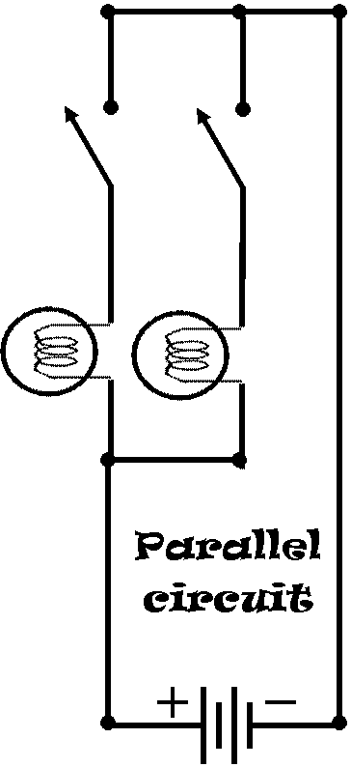
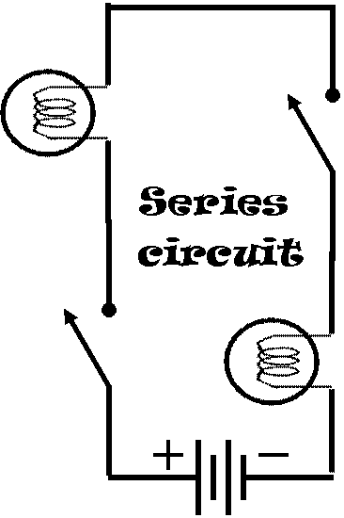

Switch 1
Switch 2
Lamp 1
Lamp 2

Slide 85
7. Electric current
By historical convention, a positive electric current is defined as having the same direction of flow as any positive charge it contains, or to flow from the most positive part of a circuit to the most negative part.
Electric current defined in this manner is called “conventional electric current.”

Slide 86
7. Electric current
However, depending on the conditions, an electric current can consist of a flow of charged particles in either direction or even in both directions at once.
The positive-to-negative convention is widely used to simplify this situation.

Slide 87
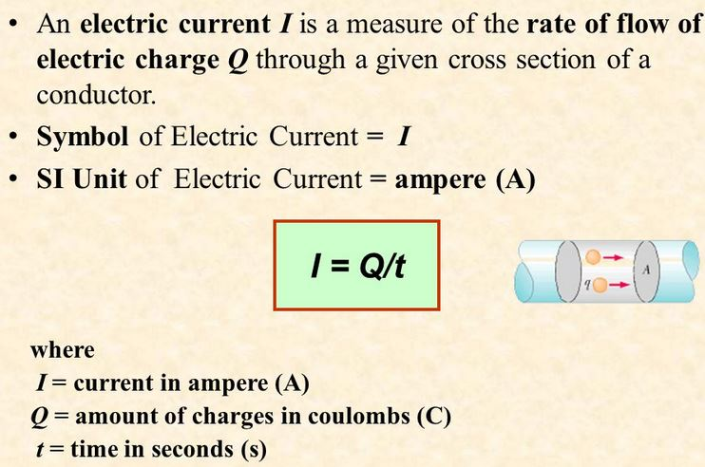
7. Electric current

Slide 88
7.1. Electrical resistance
Voltage can be thought of as the pressure pushing charges along a conductor, while “the electrical resistance of a conductor is a measure of how difficult it is to push the charges along”.
Using the water flow analogy, electrical resistance is similar to friction.

Slide 89
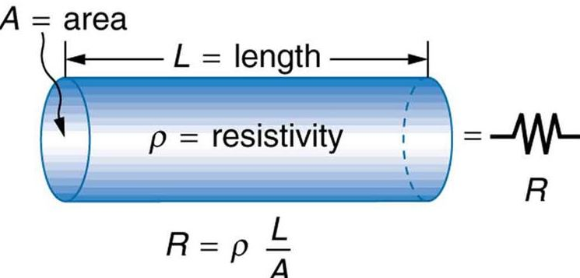
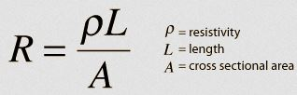
7.1. Electrical resistance
The resistance, R, of a material depends on its length (L), cross-sectional area (A), and the resistivity (ρ), a number that depends on the material:

Slide 90

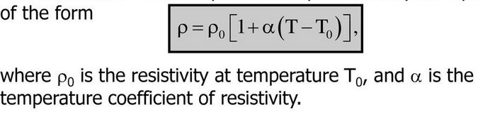
7.1. Electrical resistance
Resistance also depends on temperature, usually increasing as the temperature increases the resistance.

Slide 91
7.1. Electrical resistance
At low temperatures some materials, known as superconductors, have no resistance at all.
Resistance in wires produces a loss of energy (usually in the form of heat), so materials with no resistance produce no energy loss when currents pass through them.

Slide 92
7.2. Ohm's Law
For a current to exist in a conductor, there must be a potential difference between its ends, just as a difference in height between source and outlet is necessary for a river current to exist.
In the case of a metallic conductor, the current is proportional to the applied potential difference: Doubling V causes I to double, tripling V causes I to triple, and so forth.

Slide 93
7.2. Ohm's Law
Given:
V = Voltage
I = Current
R = Resistance
V
I
R
V=IR
I = V/R
R = V/I

Slide 94
7.4. Electromotive force and internal resistance
Let us consider a battery as a source of energy for circuits. Because the potential difference at the battery terminals is constant in a particular circuit, the current in the circuit is constant in magnitude and direction and is called direct current. A battery is called either a source of electromotive force or, more commonly, a source of emf. (The phrase electromotive force is an unfortunate historical term, describing not a force, but rather a potential difference in volts.)

Slide 95
7.4. Electromotive force and internal resistance
The emf ε of a battery is the maximum possible voltage the battery can provide between its terminals (i.e. the emf is equal to the potential difference across the terminals of the source when no current flows.) You can think of a source of emf as a “charge pump.”
When an electric potential difference exists between two points, the source moves charges “uphill” from the lower potential to the higher. We shall generally assume the connecting wires in a circuit have no resistance. The positive terminal of a battery is at a higher potential than the negative terminal.

Slide 96
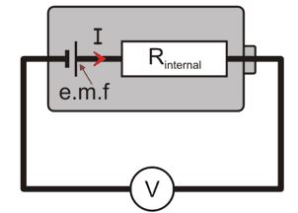
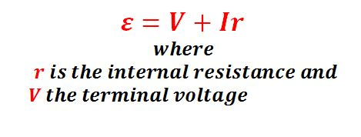
7.4. Electromotive force and internal resistance
The emf, internal resistance, terminal voltage and current drawn can be linked by the following equation:

Slide 97
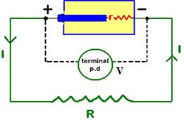

7.4. Electromotive force and internal resistance
When a battery or generator of emf ε is connected to an external resistance R, the total resistance in the circuit is R + r, and the current that flows is

Slide 98
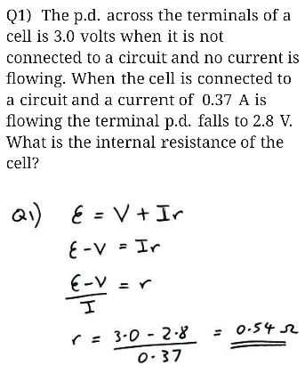
example

Slide 99
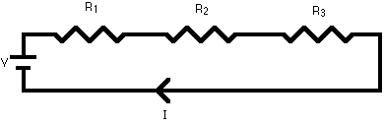
7.5. Series and parallel circuits
    a) Series circuits
A series circuit is a circuit in which resistors are arranged in a chain, so the current has only one path to take.
The current is the same through each resistor. The total resistance of the circuit is found by simply adding up the resistance values of the individual resistors. R = R₁ + R₂ + R₃ +...

Slide 100

7.5. Series and parallel circuits
    b) Parallel circuits
A parallel circuit is a circuit in which the resistors are arranged with their heads connected together, and their tails connected together.

Slide 101
7.4. Series and parallel circuits
The current in a parallel circuit breaks up, with some flowing along each parallel branch and re-combining when the branches meet again.
The voltage across each resistor in parallel is the same.

Slide 102

7.4. Series and parallel circuits
The total resistance of a set of resistors in parallel is found by adding up the reciprocals of the resistance values, and then taking the reciprocal of the total:

Slide 103


Slide 104

7.4. Series and parallel circuits
    c) Circuits with series and parallel components
    Many circuits have a combination of series and parallel resistors. Generally, the total resistance in a circuit like this is found by reducing the different series and parallel combinations step-by-step to end up with a single equivalent resistance for the circuit. This allows the current to be determined easily.

Slide 105
Quiz

Slide 106

Exercise 11

Slide 107

Exercise 12

Slide 108


Exercise 13

Slide 109


Exercise 14

Slide 110
8. Electrical Energy and power
  a) Electric energy
As already mentioned, voltage is energy per unit charge, so if you want to know how much energy has been provided by a battery, you simply multiply the voltage by the amount of charge that it has moved so far.

Slide 111
8. Electrical Energy and power
  The same formula gives the amount of electrical energy used by a light bulb or any other device that consumes electrical energy, provided that you replace the battery voltage by the potential difference (voltage difference) between one end of the device and the other:

Slide 112
8. Electrical Energy and power
In the case of resistive (Ohmic, or linear) loads; the definition of electrical current, combined with Ohm's law (V = RI) the expression for the energy is given by
The unit of electric energy is watt-second (Ws) but in commercial domain they prefer to use kilowatt-hour (kWh)

Slide 113
8. Electrical Energy and power
  Electric power
Electric power is the rate at which electric energy is transferred by an electric circuit.
The SI unit of power is the watt.
Electric power, like mechanical power, is represented by the letter P in electrical equations.
The term wattage is used colloquially to mean "electric power in watts."

Slide 114

8. Electrical Energy and power
In direct current resistive circuits, electrical power is calculated using Joule's law:
In the case of resistive (Ohmic, or linear) loads, Joule's law can be combined with Ohm's law (I = V/R) to produce alternative expressions for the dissipated power:

Slide 115

RC Circuits
We have analyzed direct-current circuits in which the current is constant. In Direct Circuits (DC circuits) containing capacitors, the current is always in the same direction but may vary in magnitude at different times. A circuit containing a series combination of a resistor and a capacitor is called an RC circuit.

Slide 116

Charging a capacitor

Slide 117

Charging a capacitor

Slide 118

Charging a capacitor

Slide 119

Charging a capacitor

Slide 120


Discharging a Capacitor

Slide 121



Slide 122


Slide 123

Exercises

Slide 124

Exercises

Slide 125

Exercises

Slide 126

Find the current through each battery. / 10marks

